Slide 1
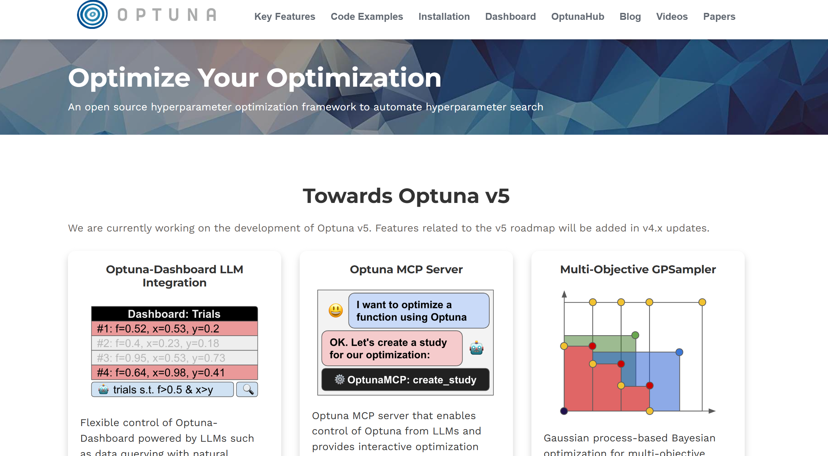
Hyperparameter optimization using Optuna
Clinical AI Study Group
Amit Saha

Slide 2
Hyperparameter tuning
ML algorithms have model parameters and objective functions – which are optimized during the learning process
Hyperparameter tuning is the process of intelligently searching the search space of the parameters that are specified for the learning – i.e., user input/configuration

Slide 3
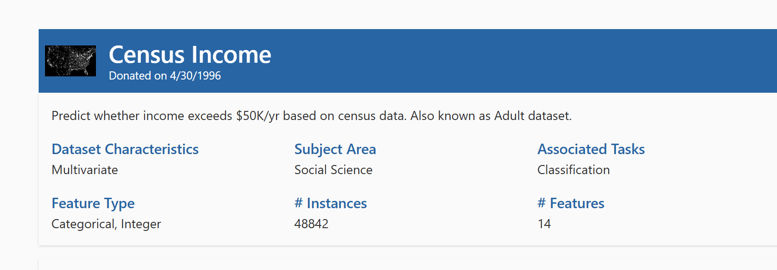
Today’s demo
XGBoost (eXtreme Gradient Boosting) as the ML algorithm for classification
Ensemble method, multiple trees
UCI adult dataset – tabular data, classification task is the income > 50k $ (USD)/year

Slide 4
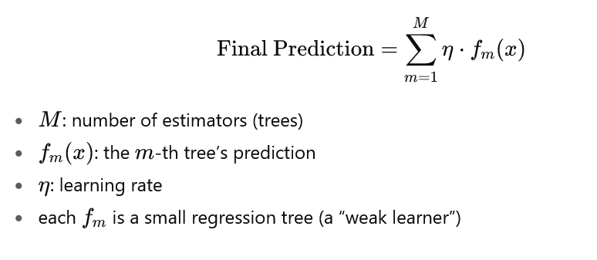
XGBoost

Slide 5
XGBoost – Hyperparameters of interest
Learning rate: step size of model weight update
Number of estimators: number of trees
Max depth: depth of each tree
Guidelines
Small learning rate with larger number of estimators
Balance between stability and training speed (lower learning rate)
More depth results in potential overfitting the training data
Higher number of estimators (boosting rounds), better accuracy

Slide 6
Hyperparameter tuning using Optuna
ML algorithm agnostic
Study – set up range of the parameters, which sampling (optimization algorithm) algorithm to use, and whether to maximize or minimize objective(s)
Trial – a single run of the ML algorithm + the parameters chosen from the study configuration

Slide 7
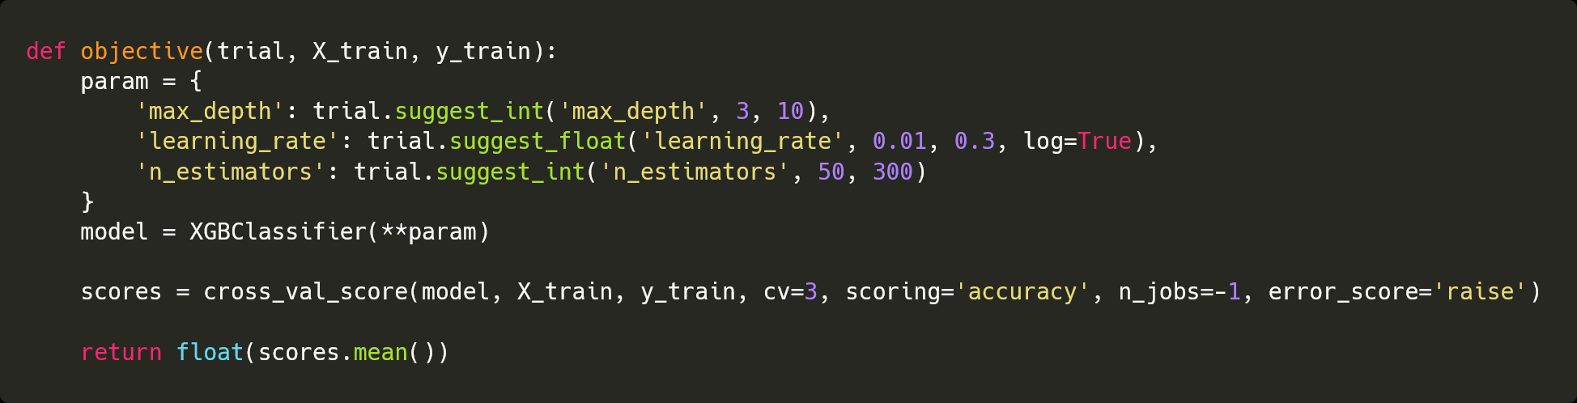
Objective function – single objective

Slide 8
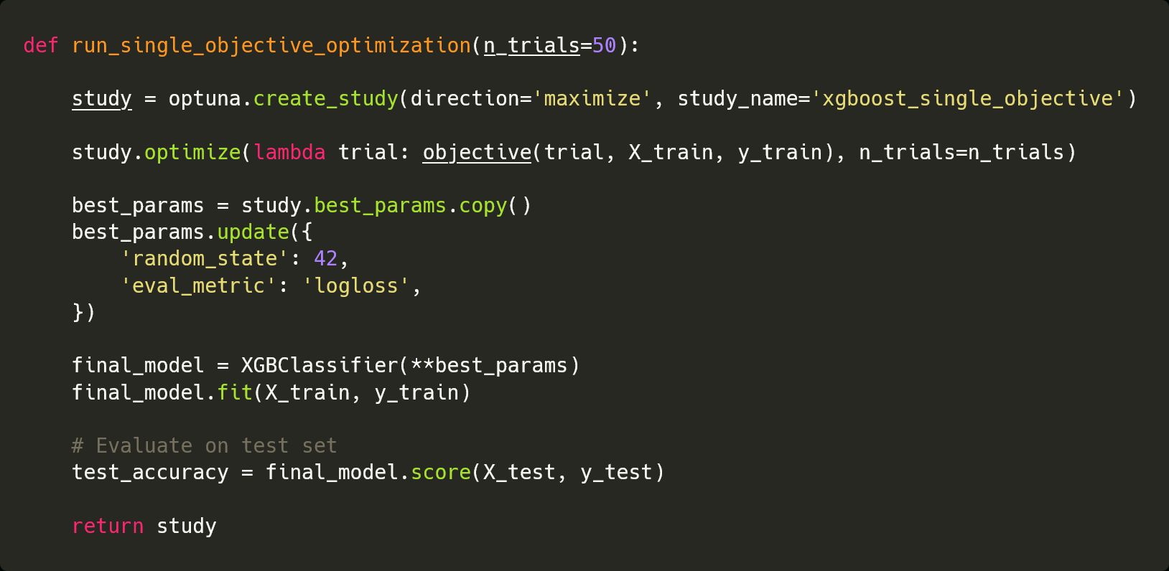
Study definition – single objective

Slide 9
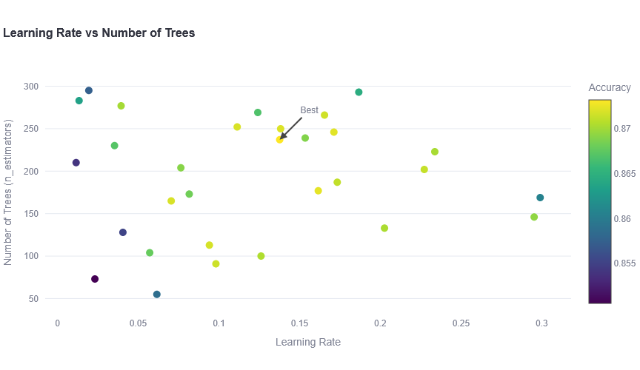
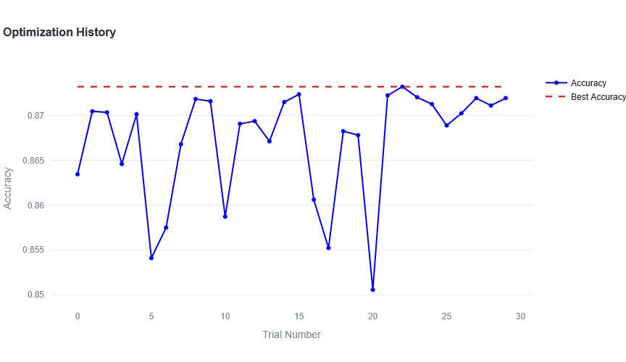

Slide 11
DEMO

Slide 12
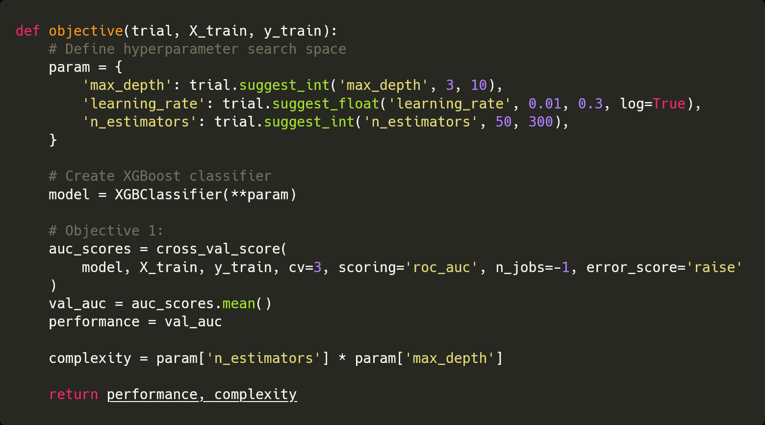
Objective function – multi objective

Slide 13
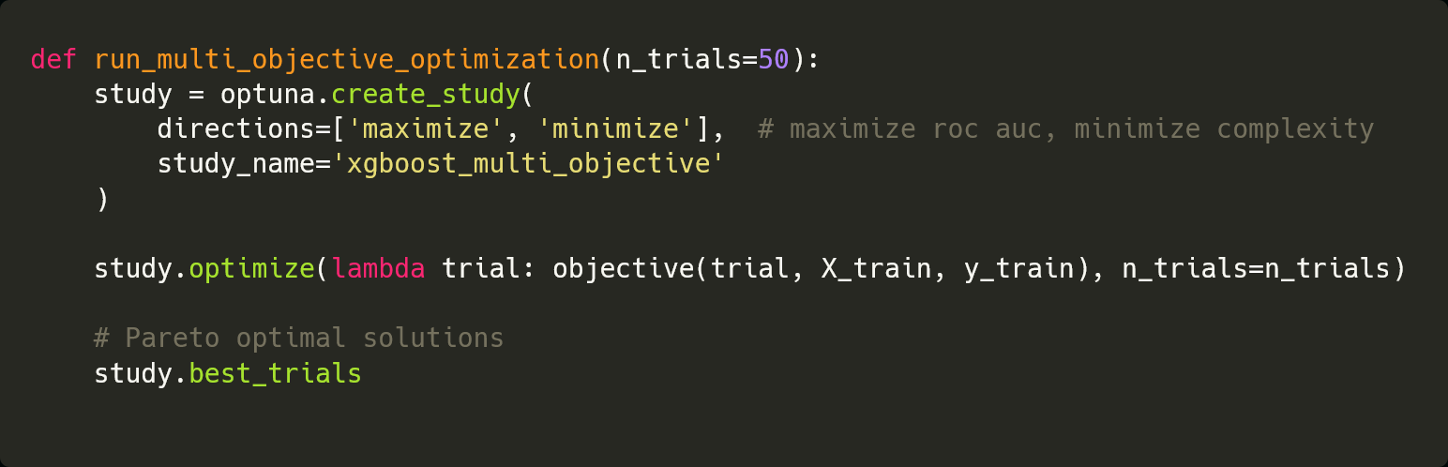
Study definition – multi objective

Slide 14
DEMO

Slide 15
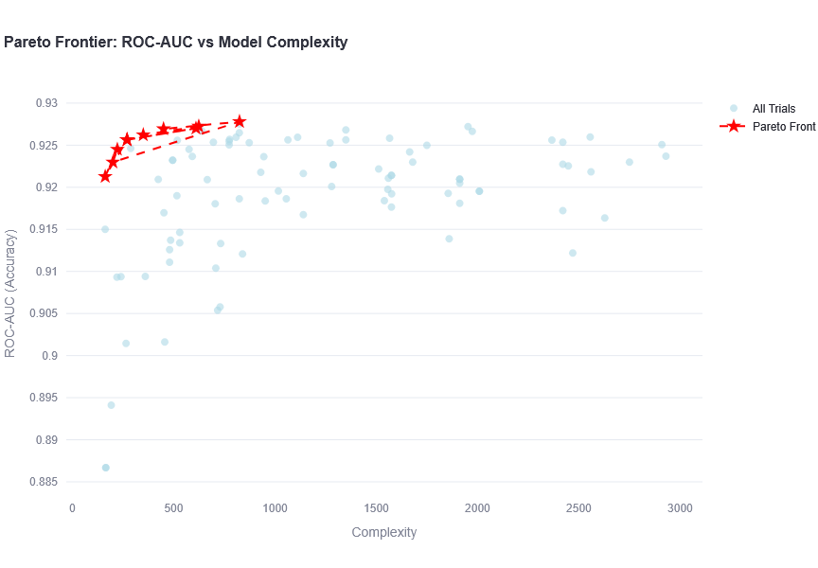
Goal:
Minimize complexity
Increase performance
Conflicting objectives
Decision making:
You cannot move up
without moving right
Notes:
Each red star = a Pareto-optimal model — one that offers the best trade-off between AUC and complexity.
You can see three main insights:
Rapid improvement early: Increasing model complexity from low to moderate levels sharply increases AUC. → e.g., the jump between ~200–500 complexity yields big accuracy gain.
Diminishing returns: Beyond ~1000–1500 complexity, the AUC gains flatten — more trees or deeper trees add little value.
Pareto frontier: The red dashed line outlines the “efficient boundary”: these are models that you cannot improve on AUC without increasing complexity.
⚖️ In decision terms
If your goal is to balance accuracy and interpretability (or cost):
Choose a point on the leftmost segment of the Pareto front (e.g., around 400–600 complexity).
If resources allow and interpretability is less critical, pick the rightmost Pareto point (around 1500 complexity) — but beyond that, you’re paying for negligible AUC improvement.

Slide 16
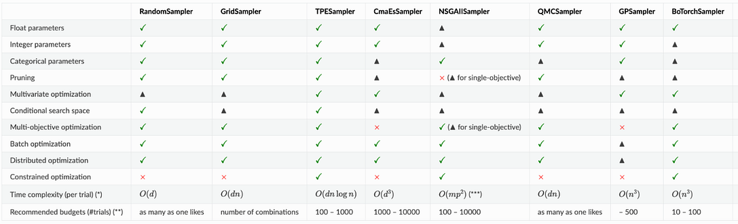
Optimization algorithms used
Optuna calls them samplers
Single objective – TPESampler (Tree-structured Parzen Estimator)
Multi-objective – NSGA-IISampler (Evolutionary algorithm based optimizer)
There is also an option to choose the sampling algorithm “automatically” based on your data - AutoSampler

Slide 17
Conclusion
Optuna makes hyperparameter tuning more manageable rather than having to manually try out various ranges
Slides, and demos: https://github.com/amitsaha/optuna-demo

